Slide 1
Smart parking
INTRODUCTION
Various devices and processes form the structure of smart parking, acting as parking space detectors. On the one hand, the deployment of sensors and/or cameras, which record and process data and images to provide real-time traffic occupancy data for the area we are heading to.
An IoT cloud-based system, on the other hand, allows these devices to be connected and the data to be centralized. The data are then analyzed using big data in order to calculate the availability of on-street parking spaces or spaces in public and private parking facilities.

Slide 2
SMART PARKING MANAGEMENT SYSTEM
Proposing a Customized Automated Vehicle Parking System.
Suitable for On street, Off street and Multi-level parking Lots.
Public can know the availability of parking vacancies in Real-time through mobile application.
Governance bodies can monitor the system from their Remote command and Control center.
Parking fees will be charged as per parking time.
Surveillance to provide security.
Recognize violation and charge them with penalty.
Entire System is according to the new parking guidelines for smart cities.
Readily Deployable System.

Slide 3
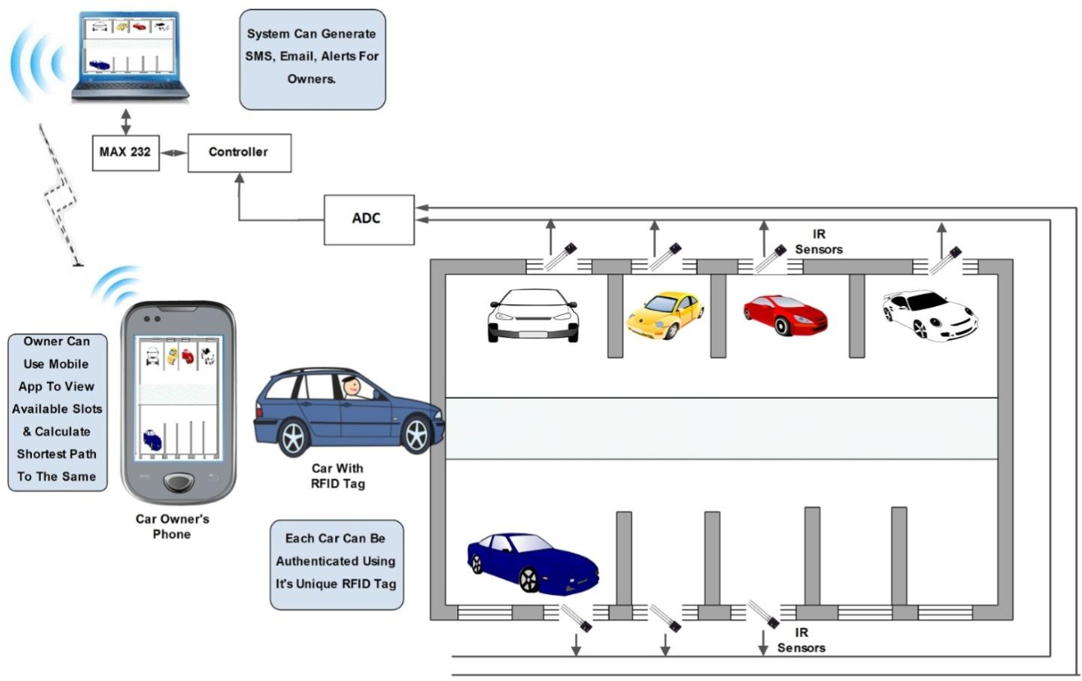
System architecture
Architecture of smart parking system

Slide 4
SMART PARKING ZONE FEATURES
Access the real time occupancy of individual parking Lots.
Parking Management Software, Mobile App for users, Web-Portal for resource management.
Real time location based view to citizens about availability of parking space.
one-to-one mapping with parking sensors
Captures & Stores the number plate images of vehicles entering and exiting parking lot.
Generation of parking receipts at the parking Lot.
Hardware failure can be reported & tracked through portal
Various reports like payment status, check-in vehicle list, check-out vehicle list, hardware active status, payment pending list etc.,
Provision for Manual Entry incase the cameras do not recognize the vehicle.
Surveillance cameras at the Parking lots provide secured monitoring

Slide 5

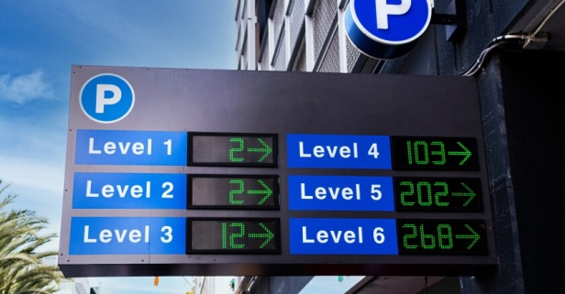
PARKING ZONE STATUS DISPLAYS
Parking Zone should be allocated either On-street or Off-street.
The parking zone is identified by Sign boards.
The On-Street Parking Zone will have no obstructions on road.
LED Signboards will be installed at the entry point of the parking Zone.
Real time vacancy availability will be displayed on LED Signboards at the entry.

Slide 6

CONCLUSION
This project will help in reducing the amount of time a driver has to spend around the parking just to find an available spot, reducing the amount of traffic around the parking and also reducing the bad parking around the parking space.

